Slide 1
ODIN II
TEAM 11
TODD TOWNSEND, ABRAM FOUTS, KARLA BARRAZA LOPEZ, WENHAO CHENG, XUENING JIA
Sponsor: Brad Smith - Intel Corporation
Advisor: Fu Li
Notes:
Bram

Slide 2
ODIN
Ocular Divergence reINtegration
Ocular Divergence
Strabismus: Abnormal alignment of the eyes
Other Forms of condition:
Amblyopia (Lazy Eye)
Diplopia (Double Vision)
Oculomotor Palsy (Unsteady Gaze)
Oculomotor Paralysis (Fixed Gaze)
Notes:
Bram

Slide 3
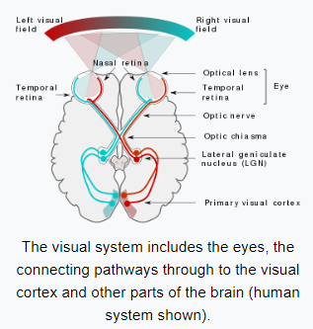
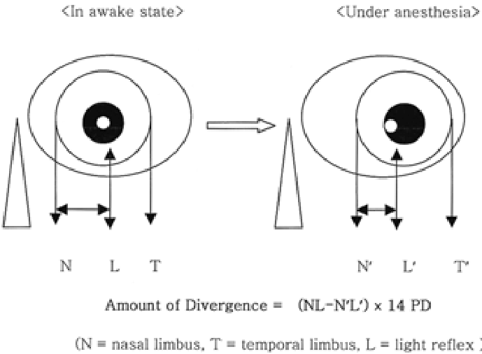
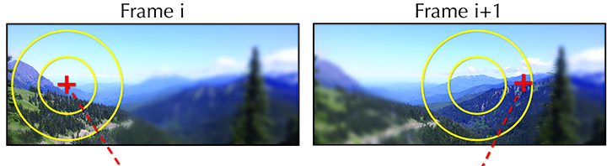
Our Project
Field of view
Using a virtual reality headset:
Obtain exact misalignment position of eye for ocular divergence patients
Use touch controllers to allow patient to control environment, manipulate space
In cooperation with neural networks, our project will manipulate the field of view
Using foveated rendering, force the ocular divergent eye to focus directly on the target
Ocular Divergence
Foveated Rendering
Notes:
Todd

Slide 4
Deliverables
1. Gaze Vectors
Application peripheral interface output hook
Apply gaze vectors to target vector
2. Touch Controller
Create custom trigger events
Obtain the 3-dimensional position and angle vectors
3. Field of View
Set up Left Camera and Right Camera
Render each Camera with the correct vectors
Notes:
Todd

Slide 5
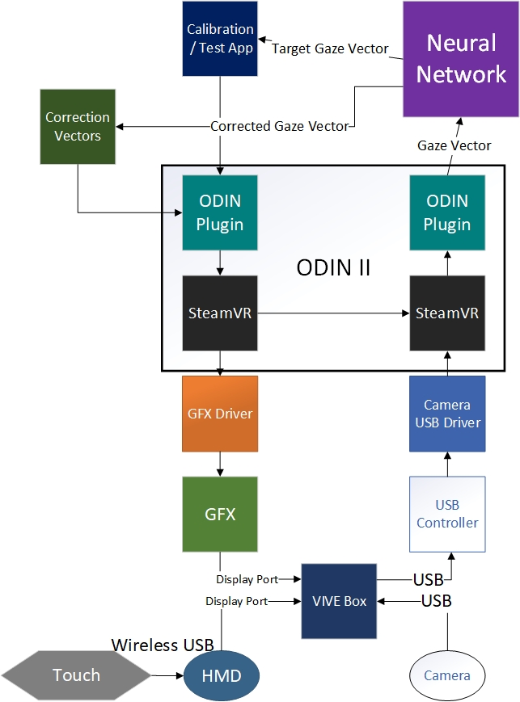
Block Diagram
Notes:
Bram

Slide 6
Our Approach
With the COVID-19 interrupted our approach changed drastically
COVID forced us to do much more research than development because the lack of access to our VR machine
We were all hands on deck looking through the given SteamVR source code and Tobii software code
We referred to the SteamVR API Documentation website
The less commonly used scripts had very little documentation
Our best friend was taking a script we think will be useful and isolating it on an object to study it.
Notes:
Karla

Slide 7
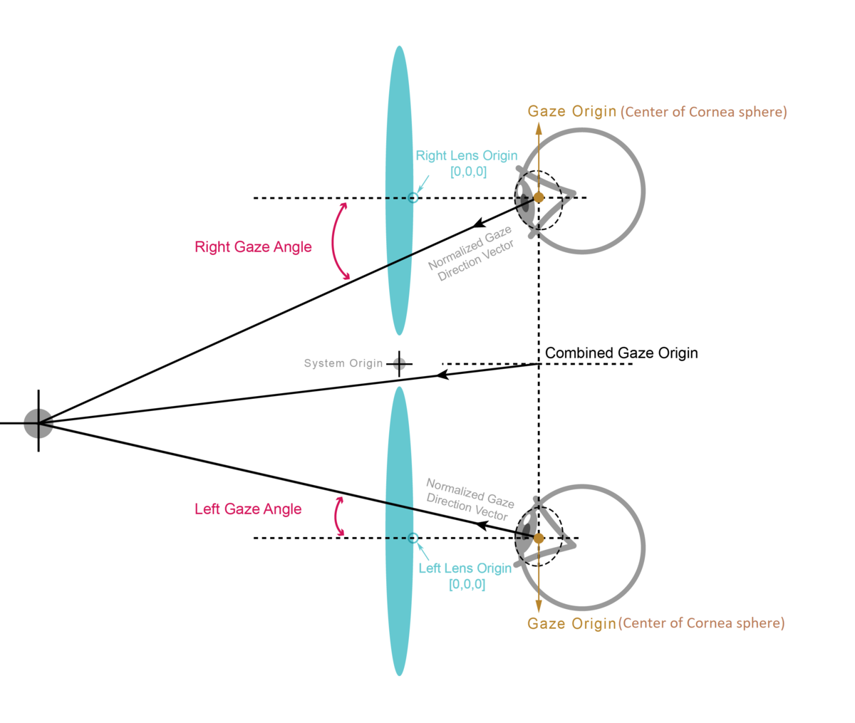
Gaze Vector
Gaze Vector focusing on singular object
X, Y, Z coordinates on a three dimensional plane
Successfully written and tested Output Function
Output function takes X, Y, Z coordinates as arguments
Connects to Tobii API
Unity command line display
Gaze Vectors then sent to Comparator
Notes:
Todd

Slide 8
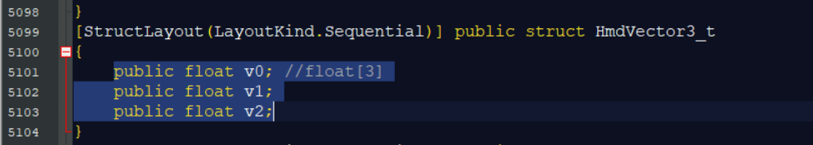
Gaze Vector API Location
Three dimensional vector for the head mounted display located in the steamVR API
Initial attempts were to write a stand alone function that sent values from the the SteamVR API to the Unity command line, then insertion into existing scripts
Found that the variables and hierarchy was very complicated, then decided to write a script within the the SteamVR API that gets called each cycle
Reference each of the variables from the inserted script
Instantiate the variables upon Unity startup
Call the display function each clock cycle with update function
Notes:
Todd

Slide 9
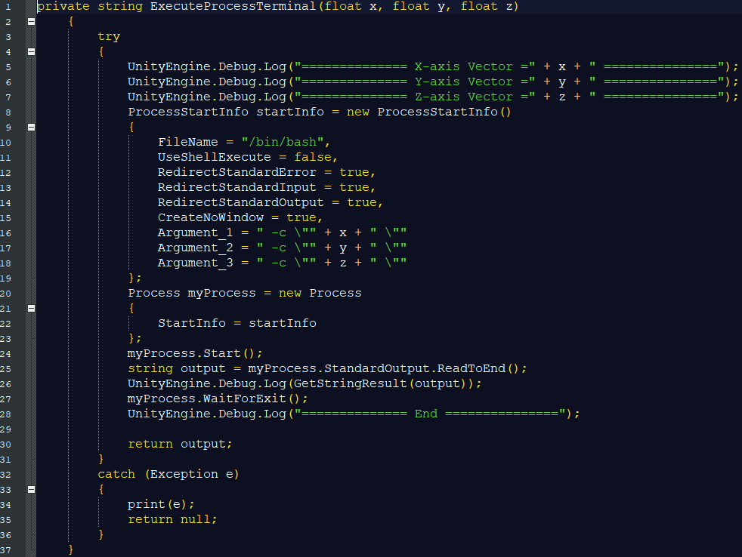
Gaze Vector Code - 1
Notes:
Todd

Slide 10
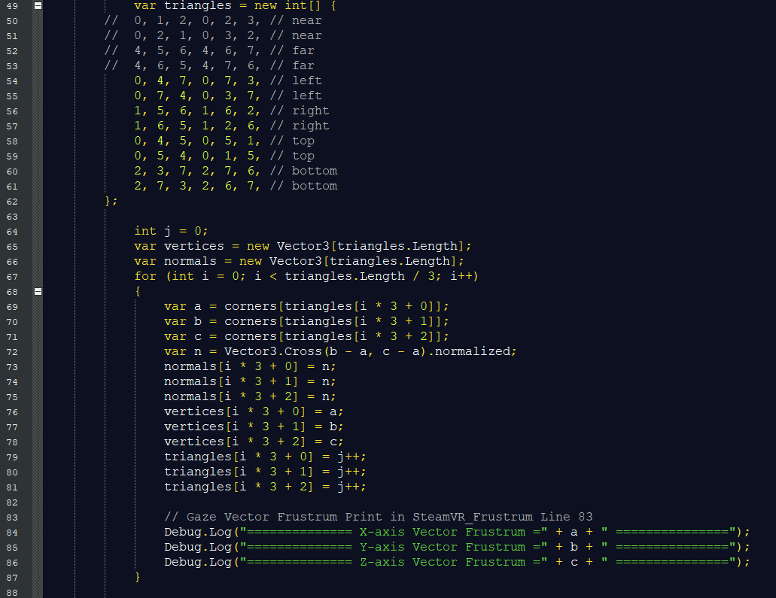
Gaze Vector Code - 2
Notes:
Todd

Slide 11
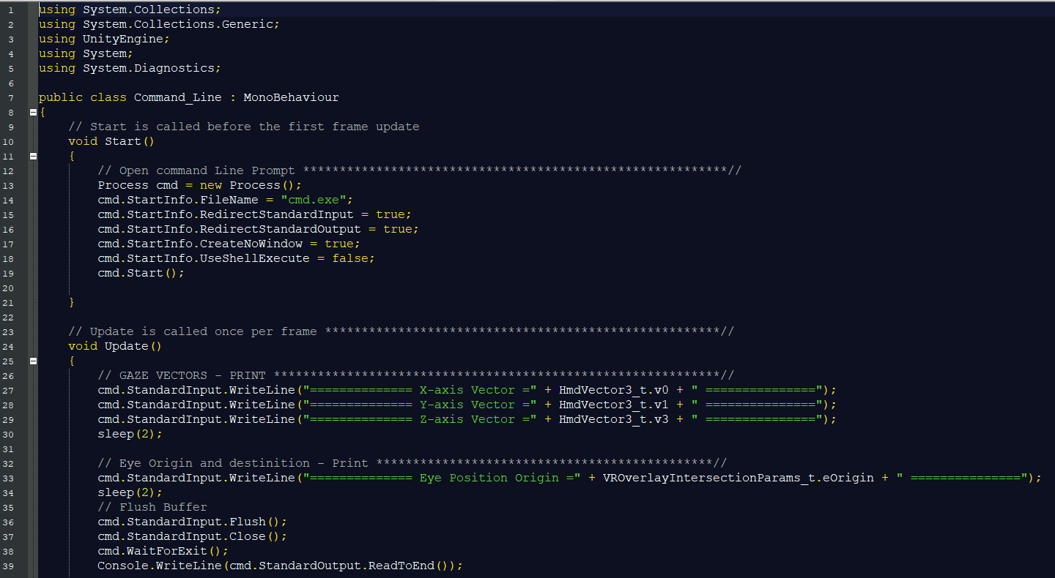
Gaze Vector Code - 3
Notes:
Todd

Slide 12
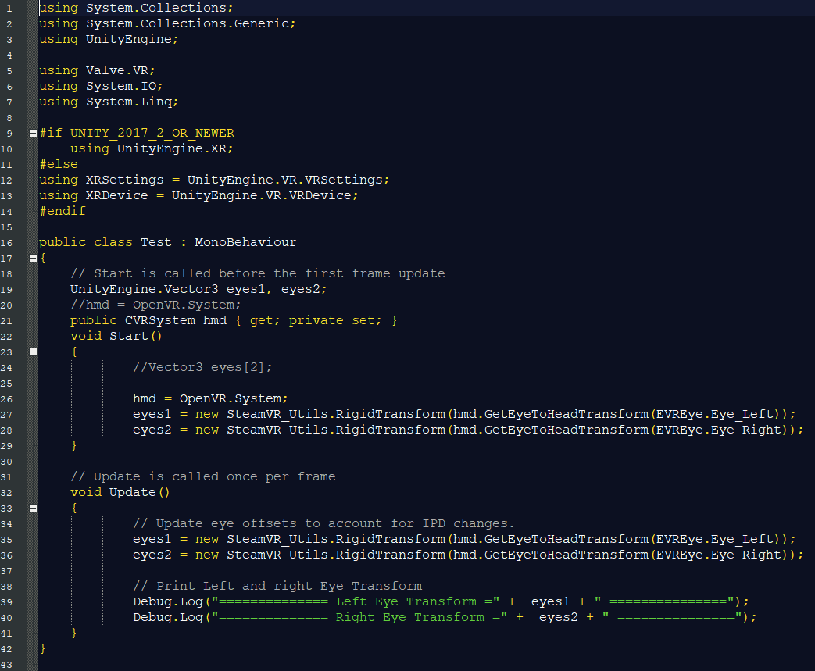
Gaze Vector Code - 4
Notes:
Todd

Slide 13
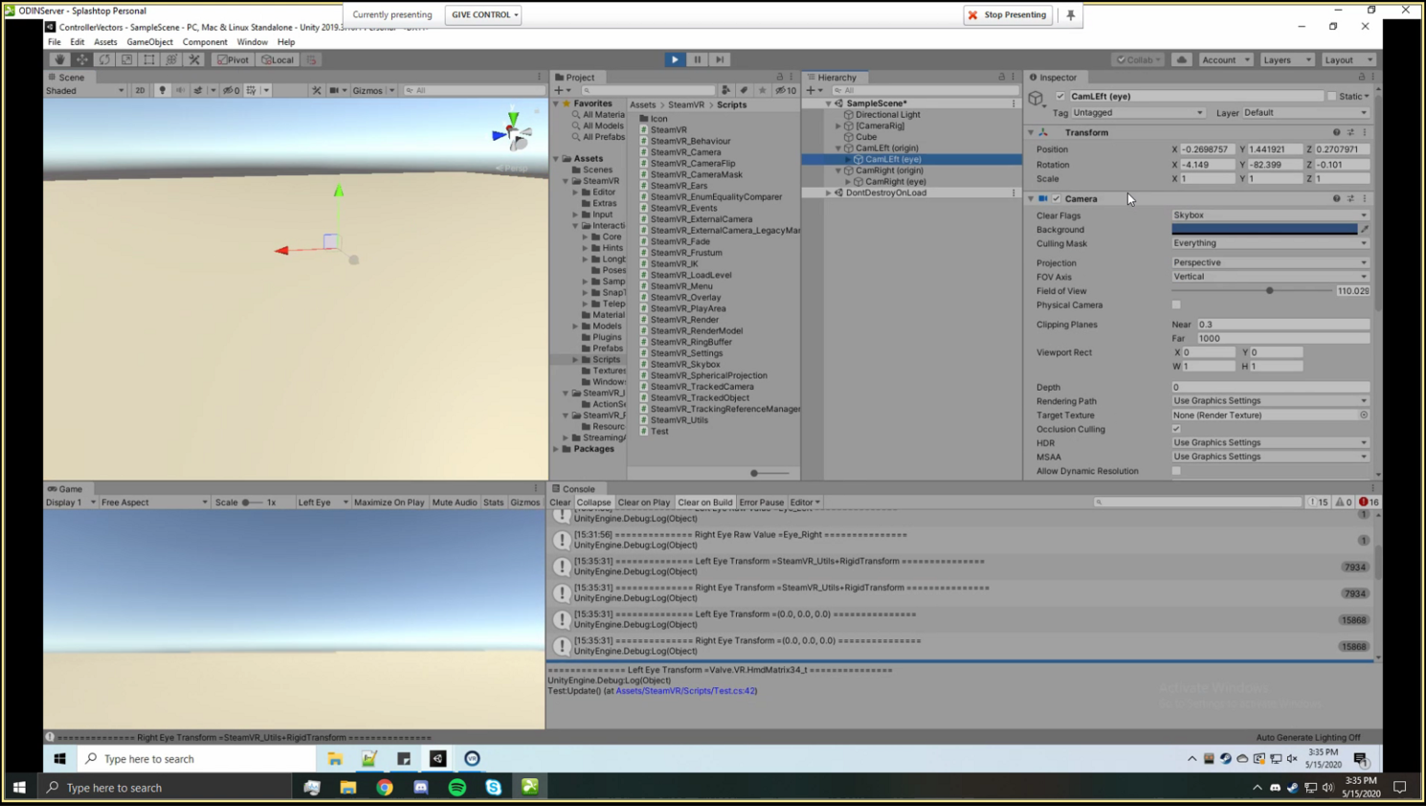
Gaze Vector
Notes:
Todd

Slide 14
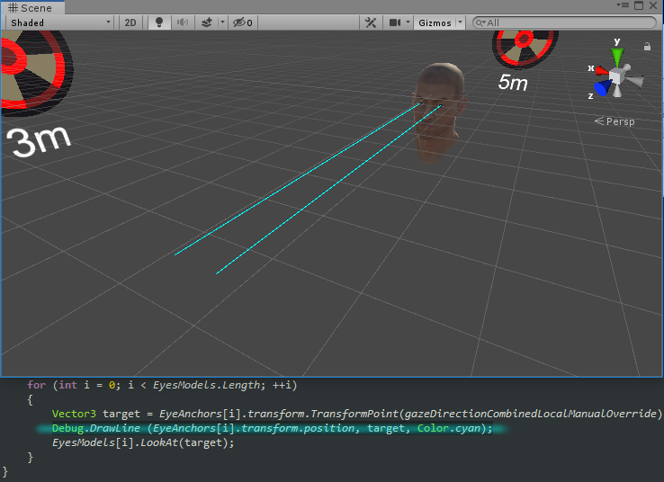
Target Vector
Exact focal position of the of the human eye focused on an object
Obtained from Calibration Test Application
Initialized upon VR HMD calibration
CNN Neural network will determine precise 3D location and calculation
Determined by a neural matrix
Gaze Vector – Target Vector = Correction Vector
Notes:
Todd

Slide 15
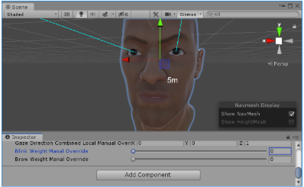
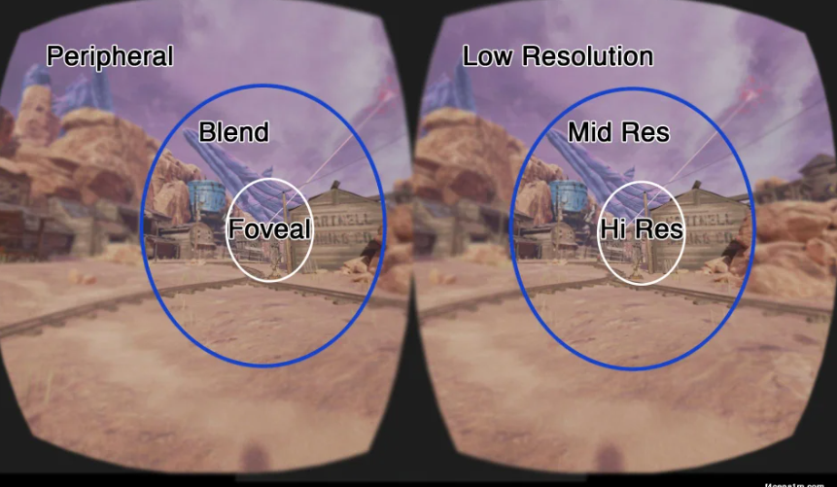
Correction Vector
COVID-19 - Correction Vectors became a should:
Comparator Function
Takes X, Y, Z coordinates from Gaze Vector as argument
Three dimensional X, Y, Z comparison
Produce Correction Vector
Correction vector sent to Unity for Foveated Rendering then into field of view on HMD
Notes:
Todd

Slide 16
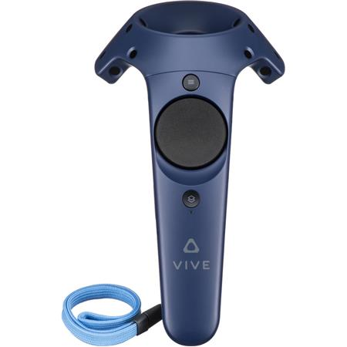
Touch Controller
Replace default touch controller trigger events with our own
Each button has unique tracking
D-pad has a boolean press and an XY coordinate touch tracker
The trigger is treated as a boolean press and a float that varies between 0.0-1.0
All other buttons are boolean presses
Notes:
Karla

Slide 17
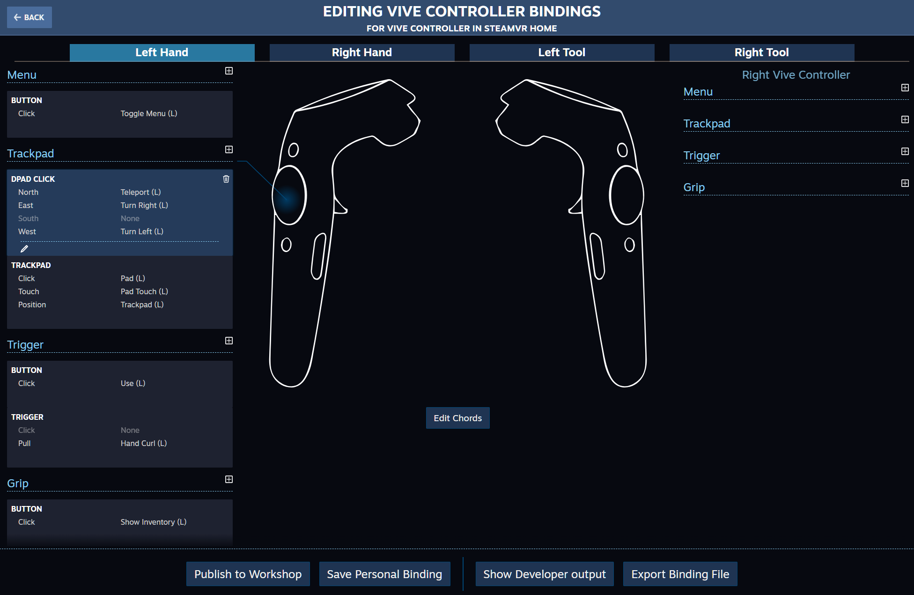
Touch Controller
With SteamVR 2.0 a bindings controller interface was introduced, so developers didn’t need to go through the redundant process of creating custom bindings
The developer simply creates functions and apply them to the corresponding trigger on either touch controller
Notes:
Karla

Slide 18
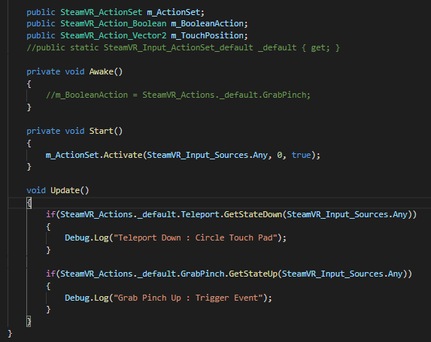
Touch Controller
This is a snippet of the touch controller input code
The script must be activated on start to receive specific or any input
It’s straightforward when you replace the default key bindings script with your custom one
Default uses the trigger as a “Grab Pinch” and the d-pad press is a “Teleport”
Notes:
Bram

Slide 19
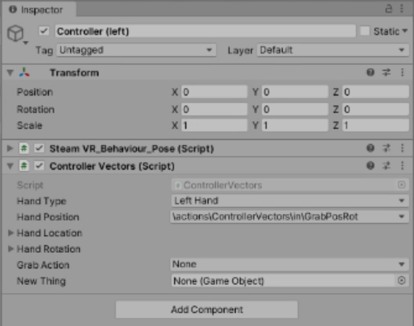
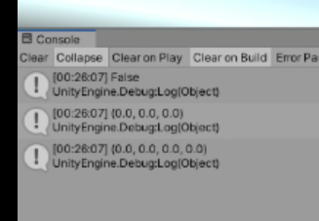
Touch Controller
Each object in unity has a transform that holds position and rotation information
We attached an action to the controller via the binding that would return the rotation and position of the controller
Location
Rotation
This screenshot was taken before the controller was actually awake
Notes:
Karla

Slide 20
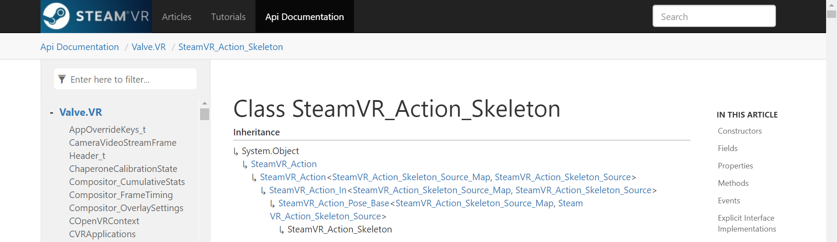
Touch Controller
To retrieve the location and position, the action type that we selected was SteamVR_Action_Skeleton
This action type contains inherent members that store the position (vector3[] data type) and rotation (quaternion data type) that we would be able to pull more easily from an object defined in our script:
public SteamVR_Action_Skeleton handPosition;
Notes:
Karla

Slide 21
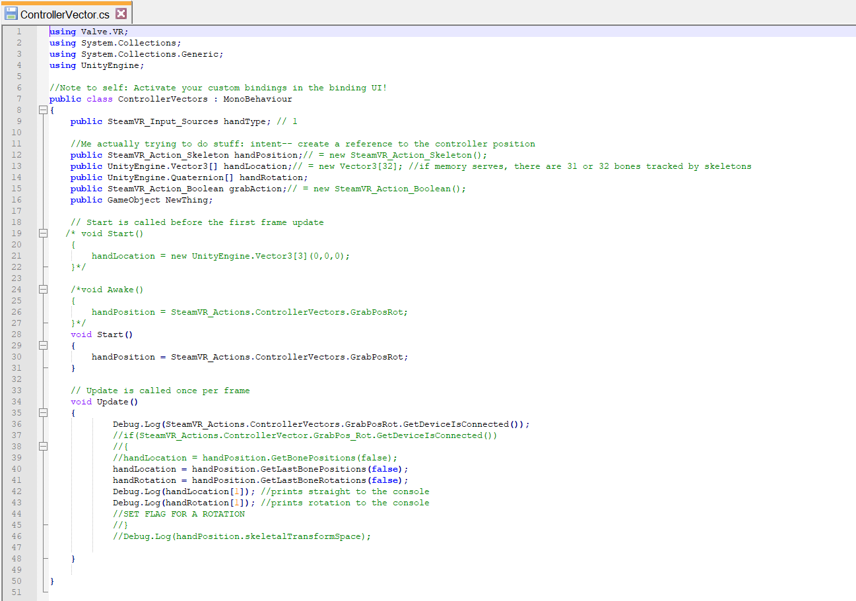
Notes:
Karla

Slide 22
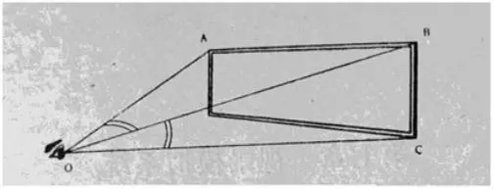
Field of View (FOV)
In VR devices, the field of view refers to the field of view in the horizontal direction.
The size of the field of view directly affects the clarity and immersion of the field of view.
The highest and lowest rays we can see are refracted into the eye through the lens, and the angle between the two refractive lines is FOV.
Notes:
Xuening/Wenhao

Slide 23
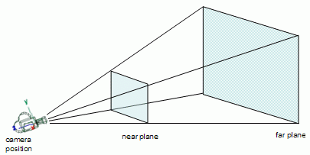
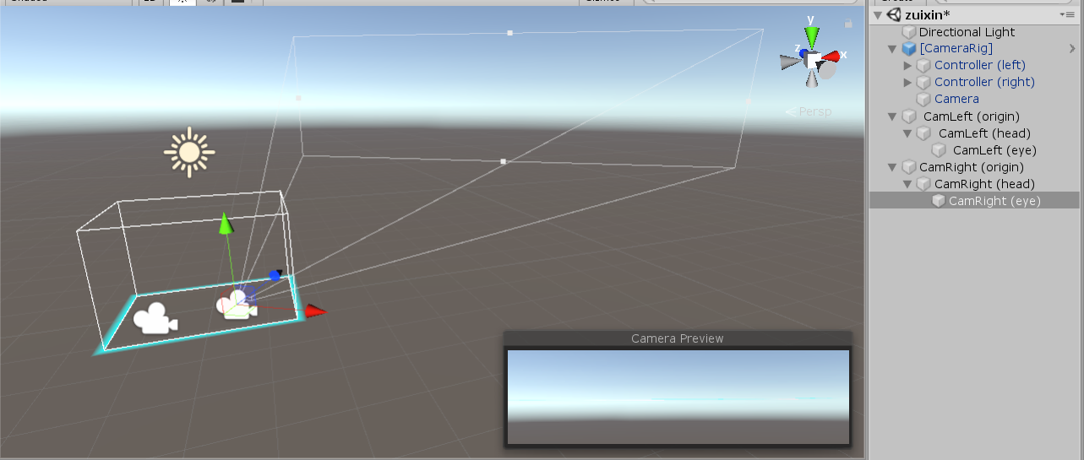
Field of View
Making the left and right eyes display content separately; (Set up Left Camera and Right Camera)
Using correction vectors and apply them to the two frustums (FOV); （Move frustums through the correction vector）
Notes:
Xuening/Wenhao

Slide 24
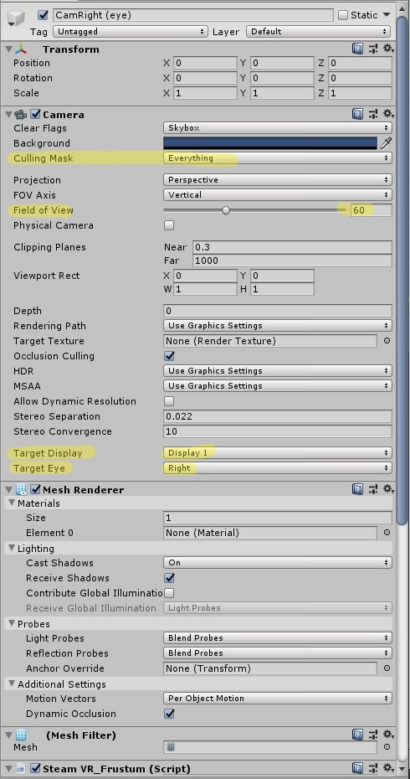
Field of View
How to add cameras for both eyes
Notes:
Xuening/Wenhao

Slide 25
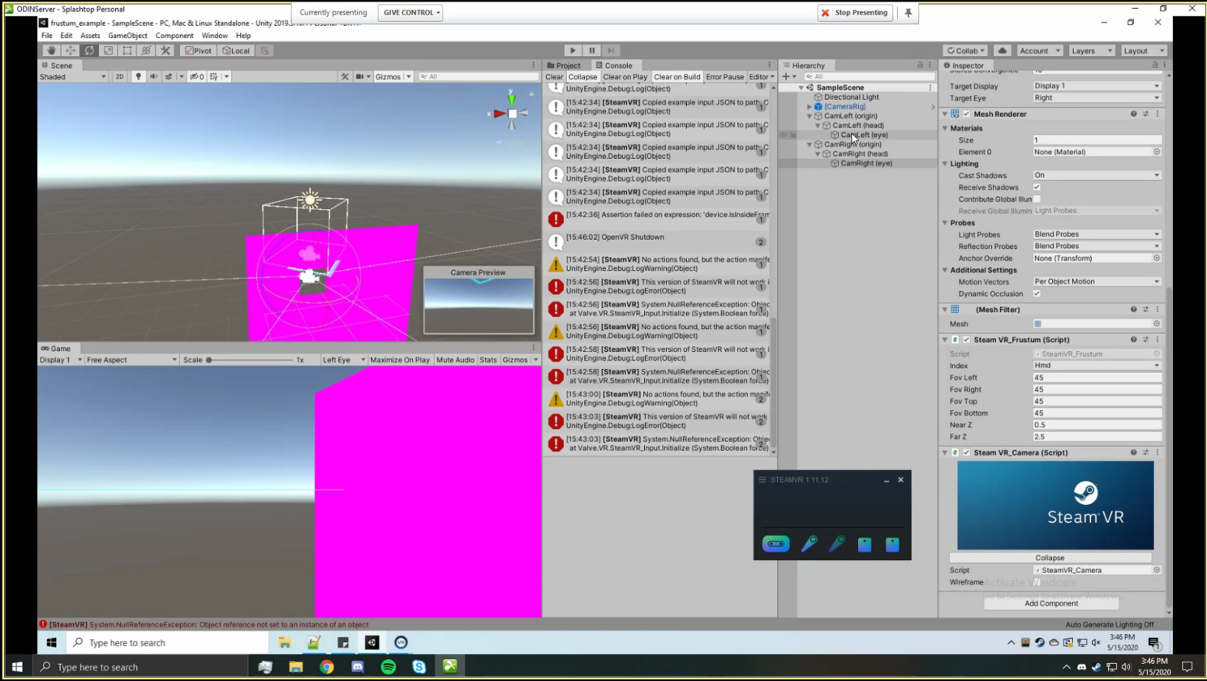
Field of View
Notes:
Xuening/Wenhao

Slide 26
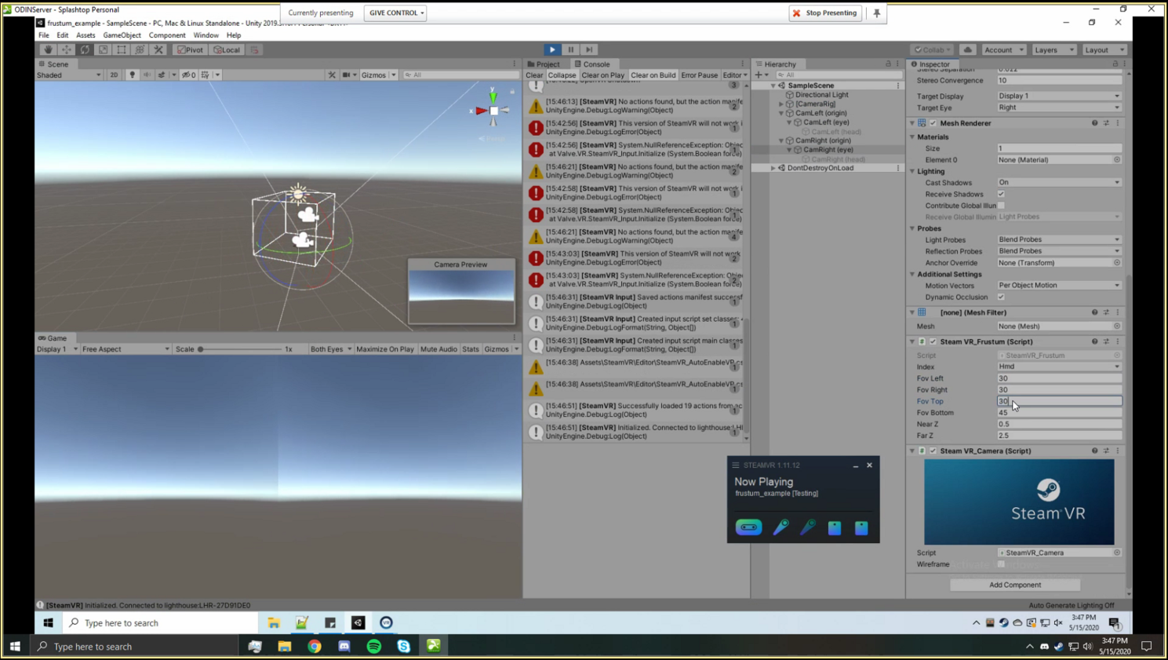
Field of View
Notes:
Xuening/Wenhao

Slide 27
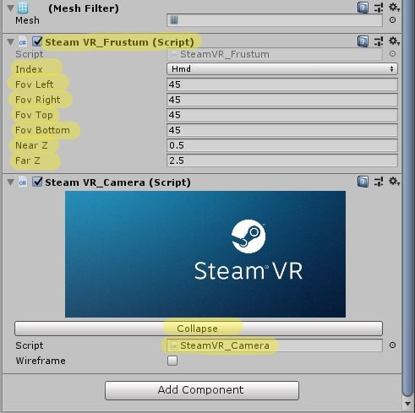
Field of View
Here is a frustum script we found called, SteamVR_Frustum.
When applied to the split camera it displays a purple frustum on the eye in edit mode, unfortunately it does not appear to do any LIVE changes
Notes:
Bram

Slide 28
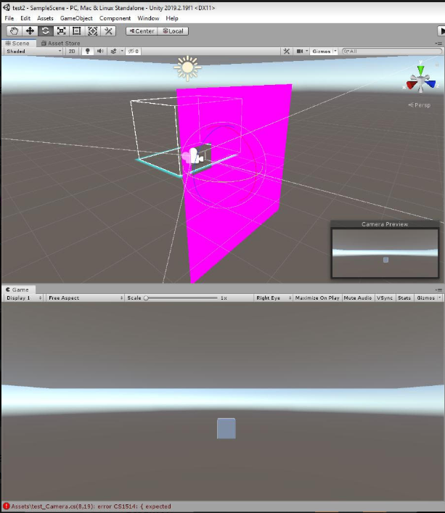
Field of View
In the attempts to manipulate the frustum we discovered that we can rotate each eye individually which would is a partial deliverable for the FOV manipulation
Notes:
Bram

Slide 29
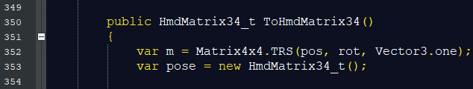
Field of View Code
The field of view is determined by a twelve point vector
Referencing HMDMatrix34_t
This vector references the field of view through the head mounted display
Determined by the position of the head, and in cooperation with the angle and position of the gaze vector
First coding attempts were to add command line output calls into existing scripts
Found that the syntax was correct, but function was not called consistently
Second coding attempt was to create a new script that is called every cycle similarly to the gaze vector
Notes:
Todd

Slide 30
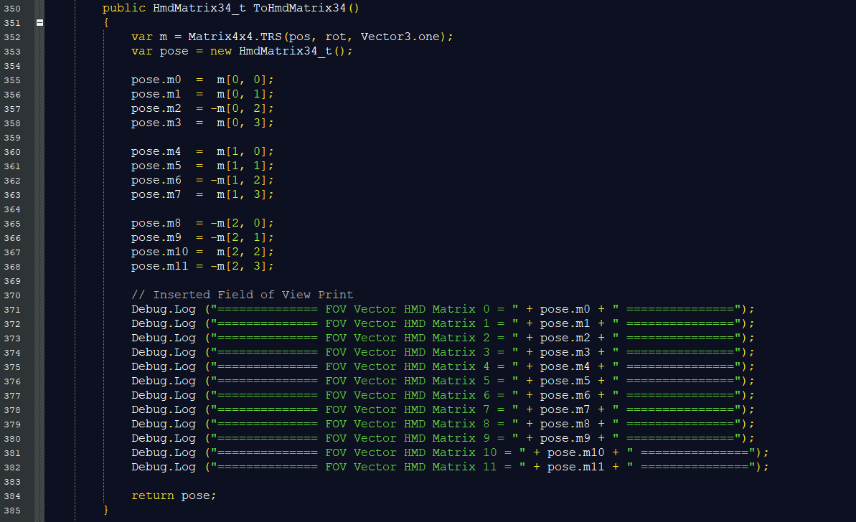
Field of View Code - 1
Notes:
Todd

Slide 31
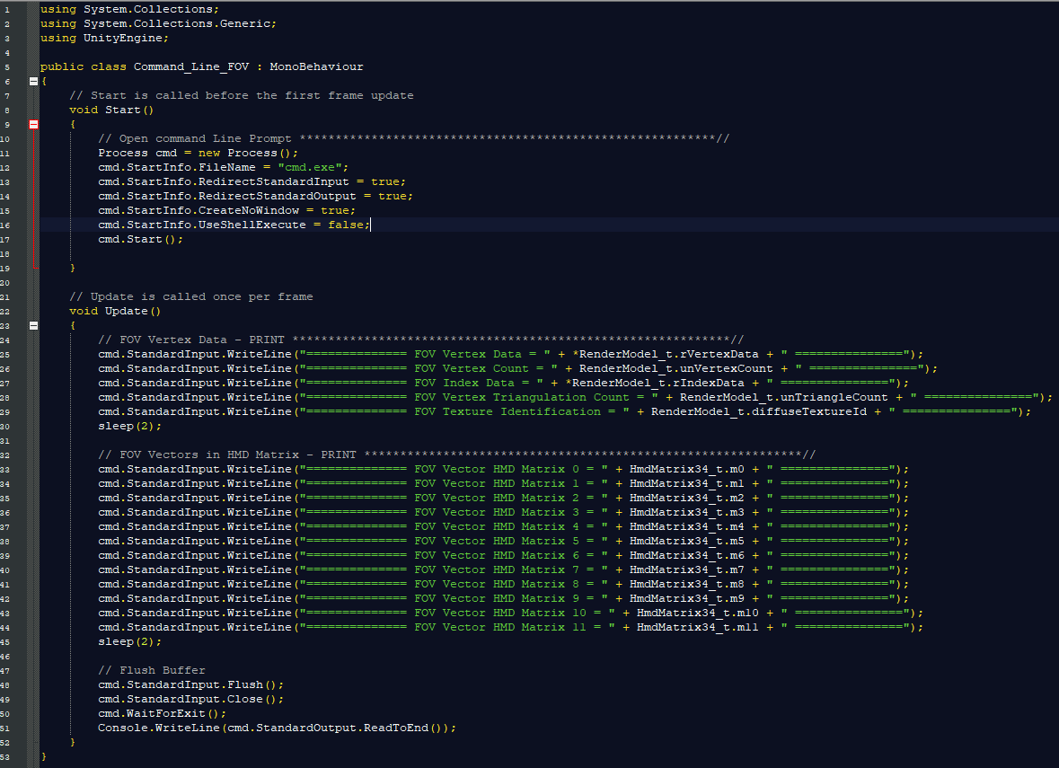
Field of View Code - 2
Notes:
Todd

Slide 32
IP
Our team owns the IP to all of the work we have done
Intel plans on us to sign it over
Intellectual property rights will be owned by Brad Smith and Intel with our signed statement
Including code, documentation, and research
Notes:
Bram

Slide 33
Testing
Once we found scripts or functions that produced or used values we were interested in we isolated them on a gameobject in Unity or our HMD
The goal was to find where certain values were being produced and extract them out
The simplest test scripts (hello world) were in place to show we found the correct function or implemented working code
We used our industry advisor and his kids as a guinea pig for every test (COVID solution)
Notes:
Bram

Slide 34
Results
Gaze Vectors:
Automated script works together with the Tobii API
x, y, z coordinates of gaze vector are locked and referenced in Unity API
Raw gaze vector values are imported from Tobii API to Unity API
Touch Controllers:
Our script connects the controller with the code and outputs location and rotation, but not live updating rotation and location
Field of View:
Twelve point field of view vector is referenced from script to Unity API
Dereferencing variables causes Unity to throw run-time errors
Instances of variable types in script are not matching Unity API requirements
Notes:
Todd/Karla/Todd

Slide 35
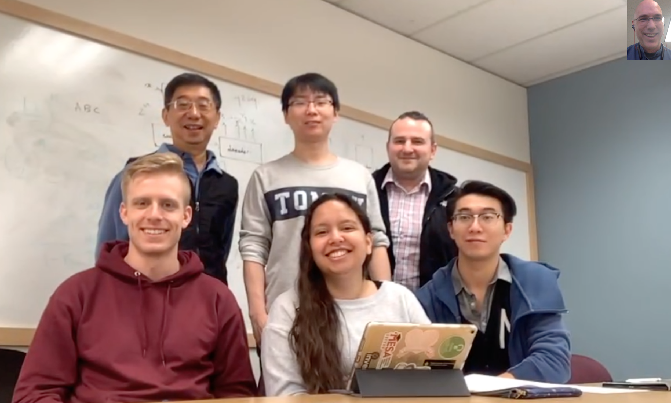
Contributions
Gaze Vectors
Todd & Karla
Touch Controllers
Bram & Karla
FOV
Xuening, Wenhao & Bram

Slide 36
Conclusion
Ocular Divergence reINtegration
Is a possible corrective alternative for strabismus
Replaces current solutions
Eye patches - Physical Therapy
Prism Glasses
Allows for corrective healing over time
Allows for fine control of visual input
Appealing to children and gamers
Gaze training with consumer VR equipment
Reduces the probability of future corrective surgery
Notes:
Todd

